Slide 1
CSE 215: Algorithms
Spring 2014
String Matching Algorithms
Chapter 32
Notes:
I joined the UMass Lowell Computer Science faculty this summer. This collection of slides is intended to familiarize the reader/viewer with my field of research (Computational Geometry), summarize my previous research results in this field and outline my plan for Computational Geometry research at UMass Lowell.

Slide 2
Chapter Dependencies
Ch 32
String Matching
You’re responsible for material in Sections 32.1-32.4 of this chapter.
Automata

Slide 3
String Matching Algorithms
Motivation & Basics

Slide 4
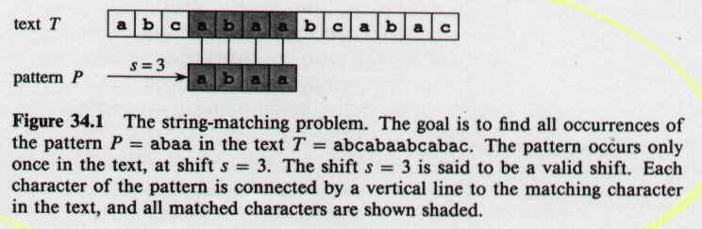


String Matching Problem
Motivations: text-editing, pattern matching in DNA sequences
32.1
Text: array T[1...n]
Pattern: array P[1...m]
Array Element: Character from finite alphabet Σ
Pattern P occurs with shift s in T if P[1...m] = T[s+1...s+m]
source: 91.503 textbook Cormen et al.

Slide 5
String Matching Algorithms
Naive Algorithm
  Worst-case running time in O((n-m+1) m)
Rabin-Karp
  Worst-case running time in O((n-m+1) m)
  Better than this on average and in practice
Finite Automaton-Based
  Worst-case running time in O(n + m|Σ|)
Knuth-Morris-Pratt
  Worst-case running time in O(n + m)

Slide 6
Notation & Terminology
Σ* = set of all finite-length strings formed using characters from alphabet Σ
Empty string: ε
|x| = length of string x
w is a prefix of x: w x
w is a suffix of x: w x
prefix, suffix are transitive
ab abcca
cca abcca

Slide 7
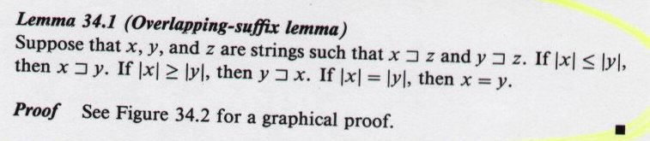
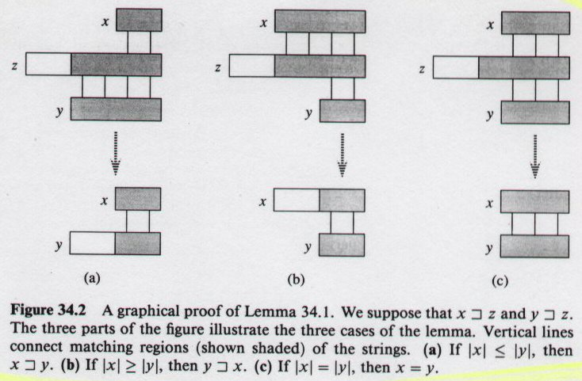
Overlapping Suffix Lemma
32.1
32.3
32.1
source: 91.503 textbook Cormen et al.

Slide 8
String Matching Algorithms
Naive Algorithm

Slide 9
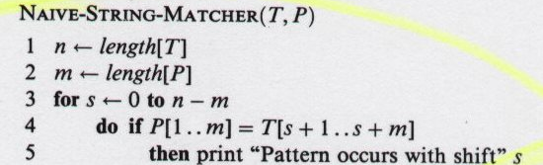
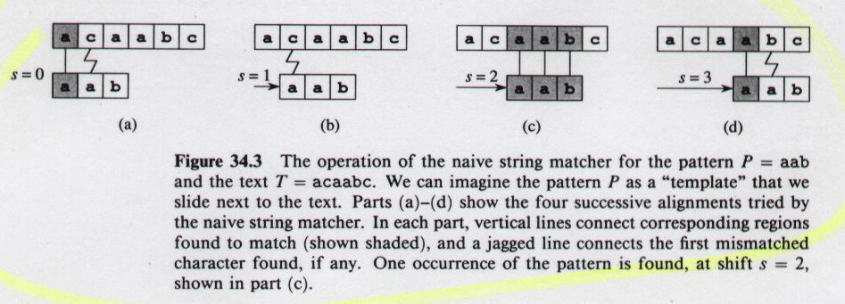
Naive String Matching
How to do better?
worst-case running time is in Θ((n-m+1)m)
32.4
source: 91.503 textbook Cormen et al.

Slide 10
String Matching Algorithms
Rabin-Karp

Slide 11
Rabin-Karp Algorithm
Assume each character is digit in radix-d notation (e.g. d=10)
p = decimal value of pattern
t_{s} = decimal value of substring T[s+1..s+m] for s = 0,1...,n-m
Strategy:
  compute p in O(m) time (which is in O(n))
  compute all t_{i} values in total of O(n) time
  find all valid shifts s in O(n) time by comparing p with each t_{s}
Compute p in O(m) time using Horner’s rule:
  p = P[m] + d(P[m-1] + d(P[m-2] + ... + d(P[2] + dP[1])))
Compute t₀ similarly from T[1..m] in O(m) time
Compute remaining t_{i}‘s in O(n-m) time
  t_{s+1} = d(t_{s} - d ^{m-1}T[s+1]) + T[s+m+1]
source: 91.503 textbook Cormen et al.

Slide 12
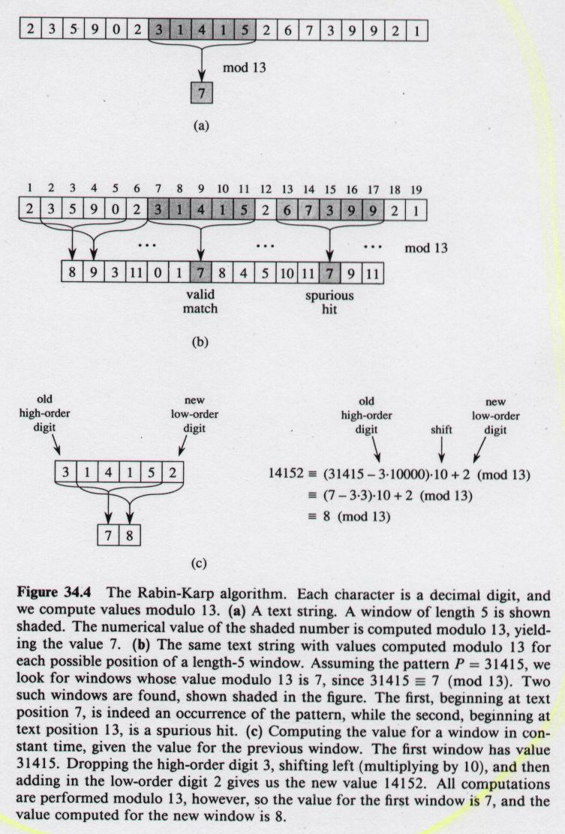
Rabin-Karp Algorithm
But...
p, t_{s} may be large, so use mod
32.5
source: 91.503 textbook Cormen et al.

Slide 13
Rabin-Karp Algorithm (continued)
But...
  t_{s+1} = d(t_{s} - d ^{m-1}T[s+1]) + T[s+m+1]
p = 31415
spurious
hit
source: 91.503 textbook Cormen et al.

Slide 14
Rabin-Karp Algorithm (continued)
source: 91.503 textbook Cormen et al.

Slide 15
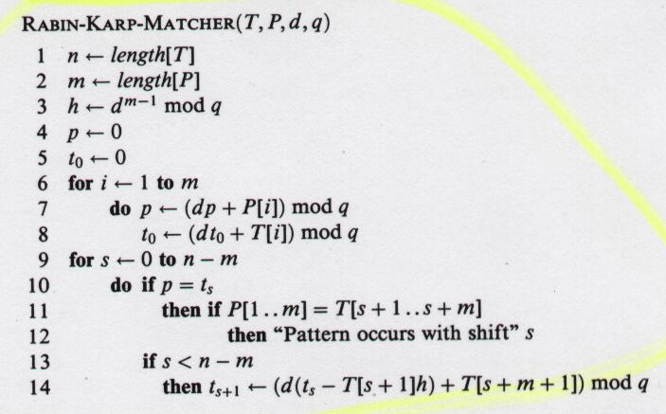
Rabin-Karp Algorithm (continued)
d is radix q is modulus
Θ(m) in Θ(n)
high-order digit position for m-digit window
Preprocessing
Θ(m)
Matching loop invariant: when line 10 executed
t_{s}=T[s+1..s+m] mod q
Θ((n-m+1)m)
rule out spurious hit
Θ(m)
Try all possible shifts
What input generates worst case?
worst-case running time is in Θ((n-m+1)m)
source: 91.503 textbook Cormen et al.

Slide 16
Rabin-Karp Algorithm (continued)
d is radix q is modulus
Θ(m) in Θ(n)
high-order digit position for m-digit window
Worst
Case
Preprocessing
Θ(m)
Matching loop invariant: when line 10 executed
t_{s}=T[s+1..s+m] mod q
Θ((n-m+1)m)
Θ(m)
rule out spurious hit
Try all possible shifts
Average Case
Assume reducing mod q is like random mapping from Σ* to Z_{q}
Estimate (chance that t_{s}= p mod q) = 1/q
# spurious hits is in O(n/q)
Expected matching time = O(n) + O(m(v + n/q))
(v = # valid shifts)
If v is in O(1) and q >= m
average-case running time is in Ο(n+m)
source: 91.503 textbook Cormen et al.

Slide 17
String Matching Algorithms
Finite Automata

Slide 18
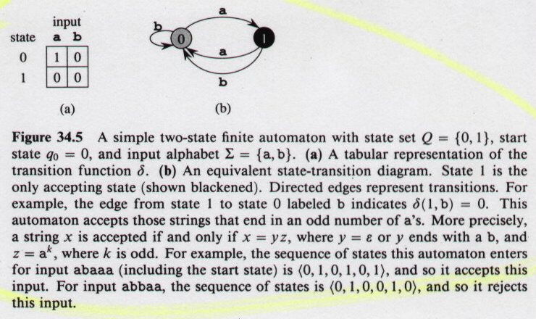
Finite Automata
32.6
source: 91.503 textbook Cormen et al.
Strategy: Build automaton for pattern, then examine each text character once.
worst-case running time is in Θ(n) + automaton creation time

Slide 19
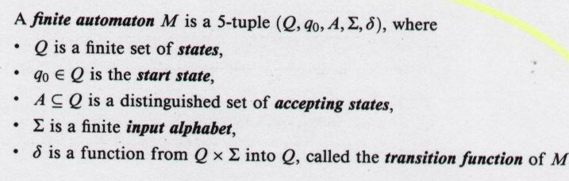
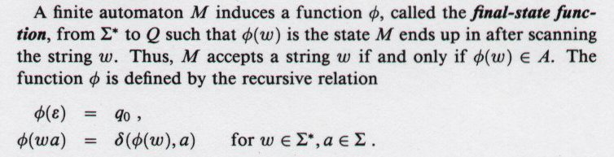
Finite Automata
source: 91.503 textbook Cormen et al.

Slide 20
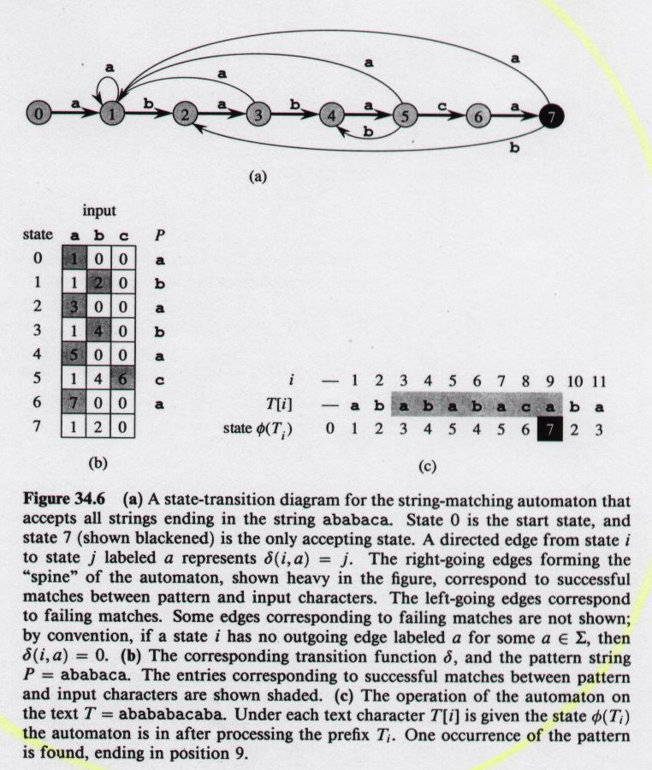
String-Matching Automaton
Pattern = P = ababaca
Automaton accepts strings ending in P
32.7
source: 91.503 textbook Cormen et al.

Slide 21
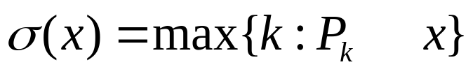
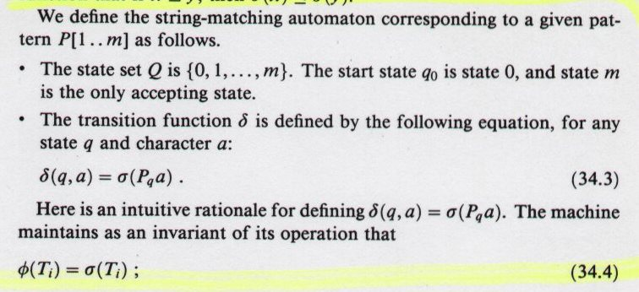
String-Matching Automaton
Suffix Function for P:
σ (x) = length of longest prefix of P that is a suffix of x
32.3
Automaton’s operational invariant
32.4
at each step: keeps track of longest pattern prefix that is a suffix of what has been read so far
source: 91.503 textbook Cormen et al.

Slide 22
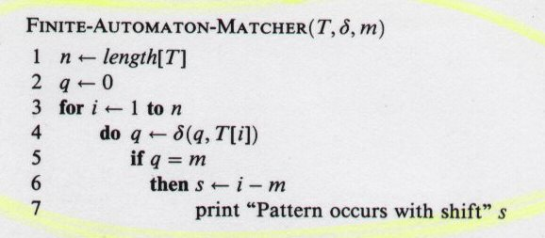
String-Matching Automaton
Simulate behavior of string-matching automaton that finds occurrences of pattern P of length m in T[1..n]
Worst
Case
assuming automaton has already been created...
worst-case running time of matching is in Θ(n)
source: 91.503 textbook Cormen et al.

Slide 23
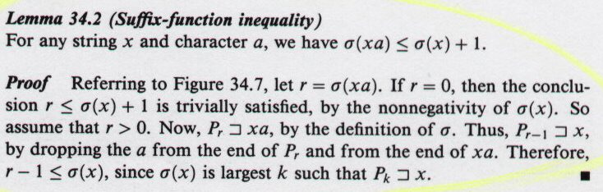
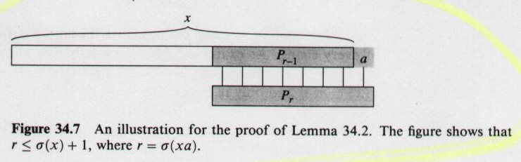
String-Matching Automaton (continued)
Correctness of matching procedure...
32.2
32.8
32.8
32.2
source: 91.503 textbook Cormen et al.

Slide 24
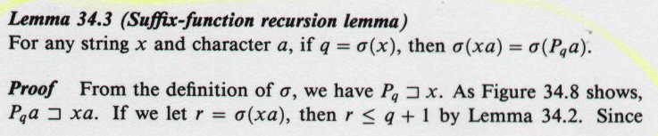
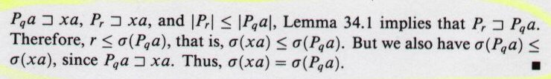
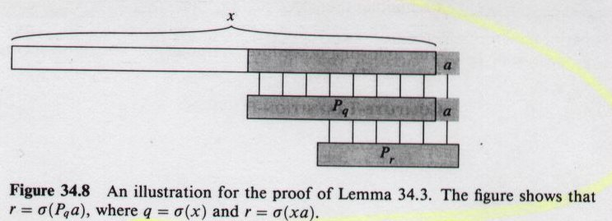
String-Matching Automaton (continued)
Correctness of matching procedure...
32.3
32.9
32.2
32.1
32.9
32.3
source: 91.503 textbook Cormen et al.

Slide 25
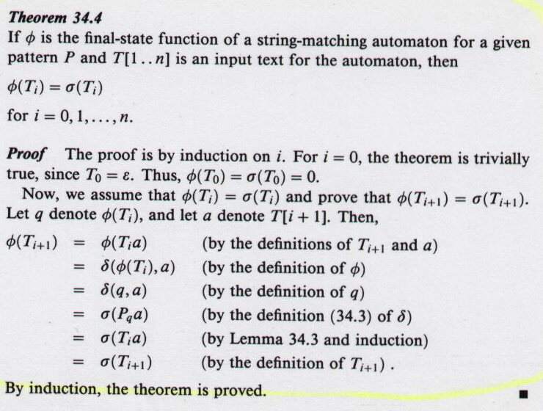
String-Matching Automaton (continued)
Correctness of matching procedure...
32.4
32.3
32.3
source: 91.503 textbook Cormen et al.

Slide 26
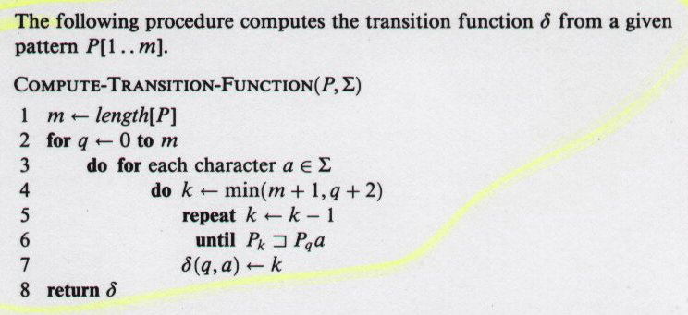
String-Matching Automaton (continued)
source: 91.503 textbook Cormen et al.
worst-case running time of automaton creation is in Ο(m³ |Σ|)
Worst
Case
can be improved to: Ο(m |Σ|)
worst-case running time of entire string-matching strategy
is in Ο(m |Σ|) + Ο(n)
automaton creation time
pattern matching time

Slide 27
String Matching Algorithms
Knuth-Morris-Pratt

Slide 28
Knuth-Morris-Pratt Overview
Achieve Θ(n+m) time by shortening automaton preprocessing time below Ο(m |Σ|)
Approach:
  don’t precompute automaton’s transition function
  calculate enough transition data “on-the-fly”
  obtain data via “alphabet-independent” pattern preprocessing
  pattern preprocessing compares pattern against shifts of itself

Slide 29
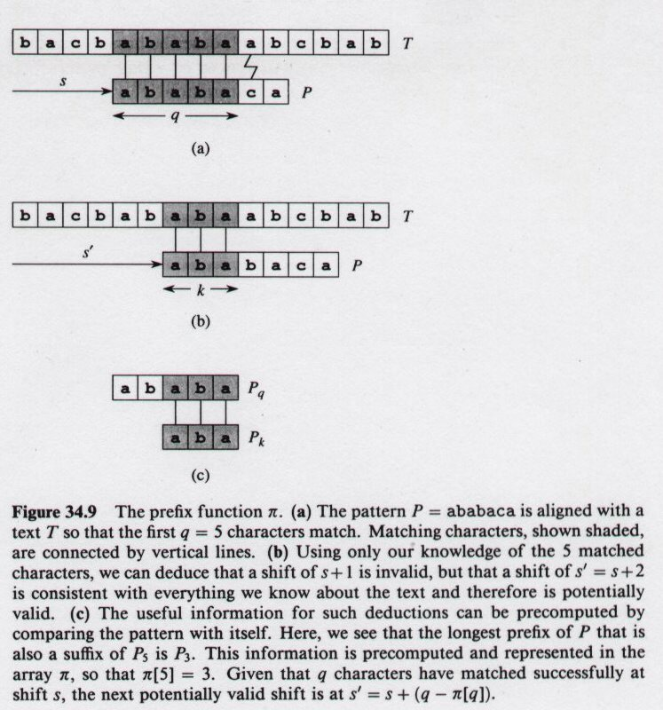
Knuth-Morris-Pratt Algorithm
determine how pattern matches against itself
32.10
source: 91.503 textbook Cormen et al.

Slide 30
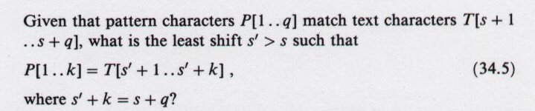
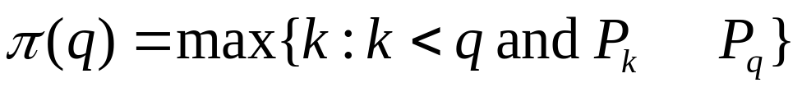
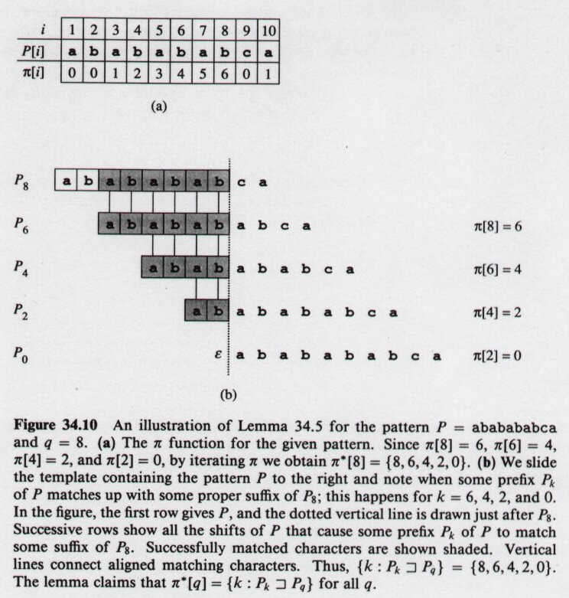
Knuth-Morris-Pratt Algorithm
32.5
Equivalently, what is largest k < q such that P_{k} P_{q}?
Prefix function π shows how pattern matches against itself
π(q) is length of longest prefix of P that is a proper suffix of P_{q}
Example:
source: 91.503 textbook Cormen et al.

Slide 31
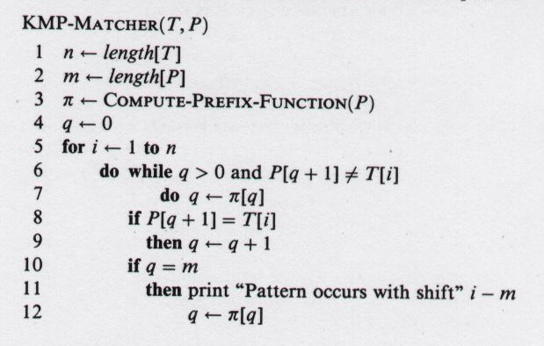
Knuth-Morris-Pratt Algorithm
Worst
Case
Θ(m) in Θ(n)
using amortized analysis
# characters matched
scan text left-to-right
Θ(m+n)
next character does not match
Θ(n)
next character matches
using amortized analysis
Is all of P matched?
Look for next match
source: 91.503 textbook Cormen et al.

Slide 32

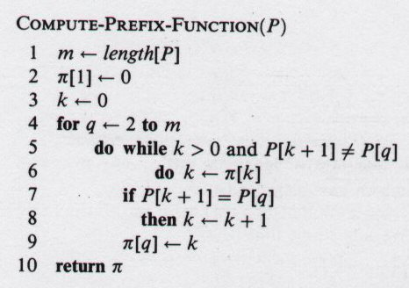
Knuth-Morris-Pratt Algorithm
Worst Case
Amortized Analysis
Potential Method
k = current state of algorithm
Potential is never negative since π (k) >= 0 for all k
Θ(m) in Θ(n)
initial potential value
potential decreases
amortized cost of loop body is in Ο(1)
Θ(m) loop iterations
potential increases by <=1 in each execution of for loop body
source: 91.503 textbook Cormen et al.

Slide 33
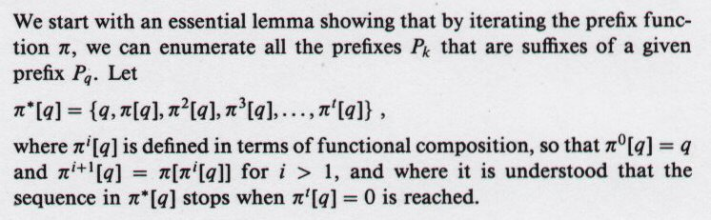
Knuth-Morris-Pratt Algorithm
Correctness...
source: 91.503 textbook Cormen et al.

Slide 34
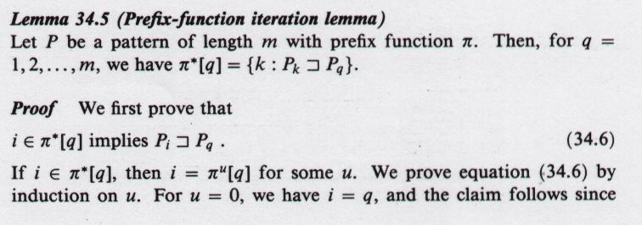
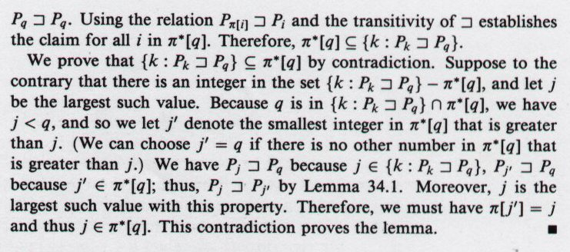
Knuth-Morris-Pratt Algorithm
32.5
Correctness...
32.6
32.6
32.1
source: 91.503 textbook Cormen et al.

Slide 35
Knuth-Morris-Pratt Algorithm
Correctness...
32.11
32.5
source: 91.503 textbook Cormen et al.

Slide 36
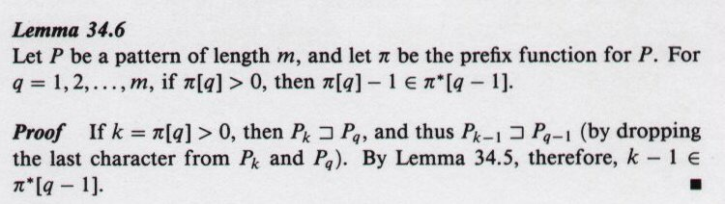
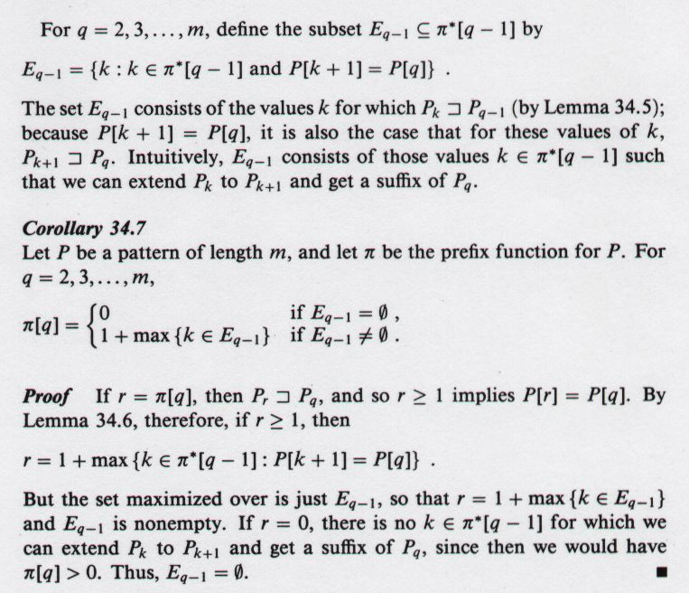
Knuth-Morris-Pratt Algorithm
32.6
Correctness...
32.5
32.5
32.7
32.6
source: 91.503 textbook Cormen et al.

